Slide 1

2022-2 APPLICATIONS AND PRACTICE IN NEURAL NETWORKS
Code Similarity Estimation
2021010192
Kim Jae Kyoung
Notes:
안녕하세요 신경망 응용수업 첫번째 프로젝트로 code similarity estimation을 골랐습니다.
Hello, I chose the project which name is code similarity estimation as the first project of the APPLICATIONS AND PRACTICE IN NEURAL NETWORKS

Slide 2


01
02
03
04
CONTENTS
Project description
Basic Model
New model
Conclusion
Notes:
We will proceed with the order of project description basic model New model conclusion.
순서는 project description basic model New model conclusion의 순서로 진행하겠습니다.

Slide 3
01 Project description
Goal & Necessity & Dataset
Goal
Estimating code similarity
Necessity
➢ Lack of software engineers compared to an increase in demand
➢ It is essential to have an automated way of analyzing, developing, and maintaining
Dataset
➢ code (folder) : 300 problems for training – Each 150 solution codes for 1 problem
code 1: python code 1 , code 2: python code 2
similar: 0 for different problems and 1 for the same problem
➢ sample_train.csv (file) : 17,970 pairs of extracted in solution codes of provided 300 problems
➢ sample_submission.csv (file) : Sample form for submission
➢ test.csv (file) : 179,700 pairs of extracted in solution codes of other 300 problems
Notes:
해당 프로젝트의 목표는 두개의 코드가 유사한 코드인지 아닌지를 예측하는 과제입니다.
The goal of the project is to predict whether the two codes are similar or not.
해당 프로젝트가 필요한 이유는 다음과 같습니다.
The following reasons are required for this project:
먼저. Lack of software engineers compared to an increase in demand
두번째는, It is essential to have an automated way of analyzing, developing, and maintaining
다음은 해당 프로젝트에 사용되는 데이터를 알아보겠습니다.
Next, let's look at the data used for the project.
먼저 code 폴더에는 학습을 위한 300개의 problems이 있습니다.
Each 150 solution codes for 1 problem
두개의 코드가 매칭되게 되며, similar columns은 두 코드가 유사한지 아닌지를 나타냅니다.
In similar column, 0 represents different problems and 1 represents the same problem
Our purpose is predict 179700(179 thousand 700) paris wheater they are similar or not.
sample_train.csv (file) : 17,970 pairs of extracted in solution codes of provided 300 problems
sample_submission.csv (file) : Sample form for submission
test.csv (file) : 179,700 pairs of extracted in solution codes of other 300 problems

Slide 4
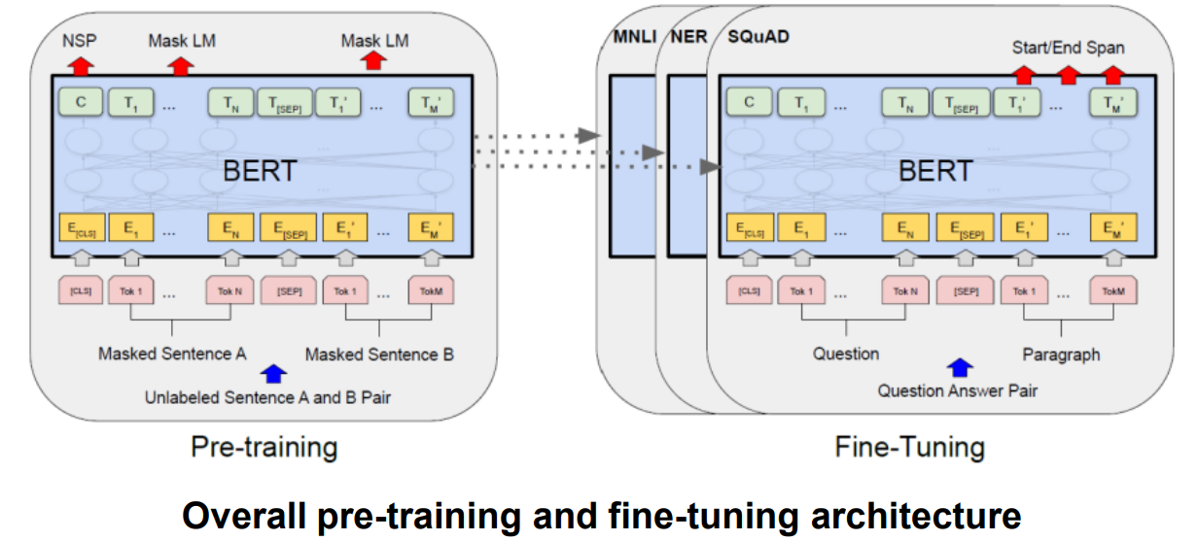
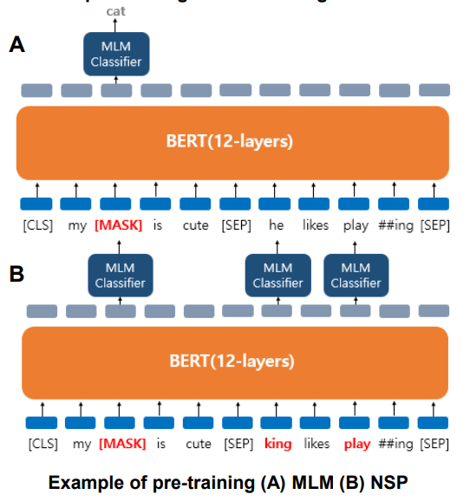
02 Basic model
BERT
Pre-training
Using massive data without labels
Masked language model (MLM) » Text random masking
Next sentence prediction (NSP) » Train with randomly concatenated sentences
Fine-tuning
Using additional tasks with labels – Single text classification
ex) emotion classification – Tagging – Question answering
Notes:
Basic model is BERT
BERT is encoder of Transformer
And as you knwo, Transformer encoder has 12 or 24 layers
Bert uses Word embedding with context.
In Pre-training of BERT , It Uses massive data without labels.
First, It uses Masked language model (MLM) and Next sentence prediction (NSP)
In Fine-tuning of BERT, It uses additional tasks with labels

Slide 5
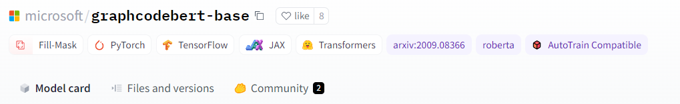
02 Basic model
Graphcodebert
Using pre-trained graphcodebert
GraphCodeBERT is a graph-based pre-trained model based on the Transformer architecture for programming language, which also considers data-flow information along with code sequences.
GraphCodeBERT consists of 12 layers, 768 dimensional hidden states, and 12 attention heads. The maximum sequence length for the model is 512.
The model is trained on the CodeSearchNet dataset, which includes 2.3M functions with document pairs for six programming languages.
Notes:
In this task, We use pretrained bert model which is praph codebert
GraphCodeBERT is a graph-based pre-trained model based on the Transformer architecture for programming language, which also considers data-flow information along with code sequences.
GraphCodeBERT consists of 12 layers, 768 dimensional hidden states, and 12 attention heads. The maximum sequence length for the model is 512.
The model is trained on the CodeSearchNet dataset, which includes 2.3M functions with document pairs for six programming languages.

Slide 6
03 New model
New preprocessing method
Preprocessing comparison
Before
After
▪Basic model
Delete \t \n
Delete http, https, java scripts
➢ Delete number
▪Our model
Delete \t \n
Delete http, https, java scripts
➢ Delete number
+
Delete between annotation terms(#)
Strip rightspaces
Remove duplicate newlines
Convert python2 code to python3
Remove imports and if __name__
Replace all types of spaces to a single space
Notes:
From now, I am going to tell the our model
I added new preprocessing method
In the previous base model, it uses ---
In our model, I added 6 things

Slide 7
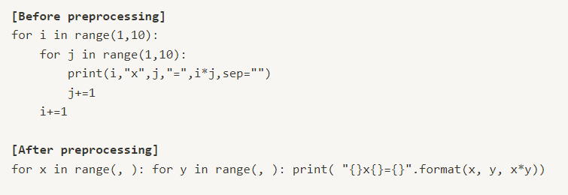
03 New model
Preprocessing
Comparison of preprocessing : sample1
Notes:
Here are the examples of preprocessing
You can see the difference between codes.

Slide 8
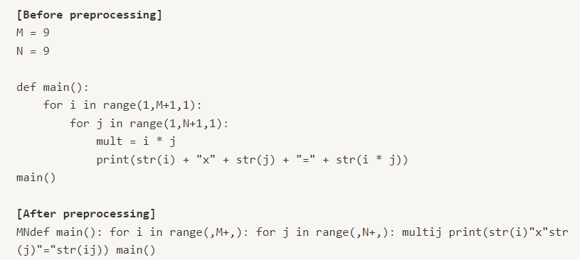
03 New model
Preprocessing
Comparison of preprocessing : sample2
Notes:
Here is the other sample
You can find the length is shortere than before

Slide 9

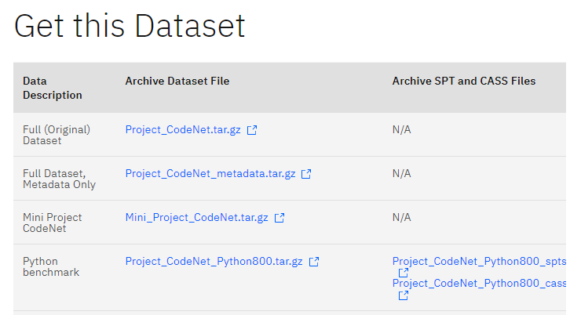
03 New model
Using codenet
Add codenet dataset
https://developer.ibm.com/exchanges/data/all/project-codenet/
Notes:
The other method that I used is adding pretrained dataset.
I found codenet dataset.
Project CodeNet is a large-scale dataset with approximately 14 million code samples, each of which is an intended solution to one of 4000 coding problems.
The code samples are written in over 50 programming languages (although the dominant languages are C++, C, Python, and Java) and they are annotated with a rich set of information, such as its code size, memory footprint, cpu run time, and status, which indicates acceptance or error types.
The rich annotation of Project CodeNet enables research in code search, code completion, code-code translation, and a myriad of other use cases.
I downloaded python benchma가 dataset which is 165MB.

Slide 10
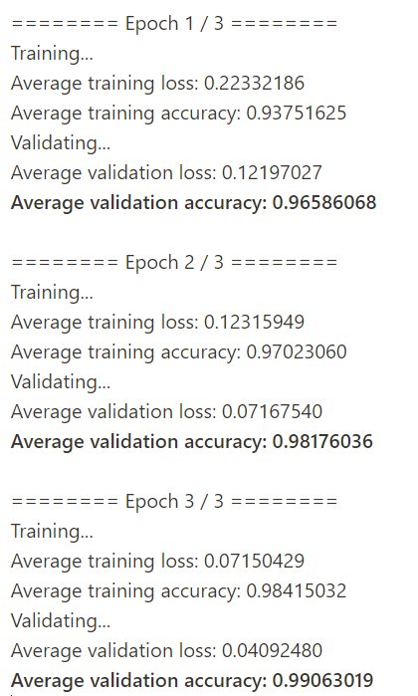
04 Conclusion
Result
Code(folder)
//
test.csv
..
Notes:
Here is the result.
Epoch is 3
We can find average loss goes down and average accuracy goes up.
Total computation time is about 3 hours. My computer is normal computer withRTX2070

Slide 11
04 Conclusion
Conclusion
Performance comparison
Before
After
+ New preprocessing method
+ CodeNet dataset
▪Basic model
Learning time: 50m 57s
➢ Validation accuracy: 95.49%
➢ Test (no label) accuracy: 89.23%
▪Our model
Learning time: 160m 37s
➢ Validation accuracy: 98.41%
➢ Test (no label) accuracy: 96.18%
Validation accuracy 2.92% up
Test accuracy 6.95% up
Notes:
Here is the conclusion.
I added new preprocessing method and codenete dataset for pretraining.
In the previous basic model, learning itme is 50minute. And test accuracy is 89%
In our model, eventhough time is 3 times but test accuracy is 96%
7% up in the test accuracy.

Slide 12

Thank you
Notes:
thanks

